Slide 1
HW2
王語麟 p76123031@gs.ncku.edu.tw
吳佩恩 p76124817@gs.ncku.edu.tw
Lab@資訊新館65701

Slide 2
Objectives
Write an Image Morphing program based on the paper
“Feature-based image metamorphosis”
https://dl.acm.org/doi/10.1145/133994.134003
Input
2 color images we offer.
Feature line segments. (You can put them in the code or let user draw on the GUI window)
Alpha value: 0 ~ 1
Output
Warped image (Before color blending).
Final result (After color blending).

Slide 3
Requirements
No limitation on Programming Language / OS
You MUST implement the warping algorithm by yourself.
No warping function (cv::warpPerspective)
You MUST implement the feature line warping algorithm based on the paper.
Record your result from the start (entering command line etc.) and remember to also include any additional features to get extra points.
Scoring heavily depends on the demo video, so please double-check it before uploading.

Slide 4
Additional
You will receive additional scores if you successfully implement and demo the following features.
Users can draw feature lines on the GUI window.
Warping animation. (Show the morphing result with alpha value from 0 to 1 continuously) e.g., alpha={0, 0.1, 0.2, …, 0.9, 1.0}
Multiple image sequentially morphing animation. (using any 3 images) (Just like 2. but using 3 images, Image A → Image B → Image C)
Other functions (Designed by yourself)

Slide 5
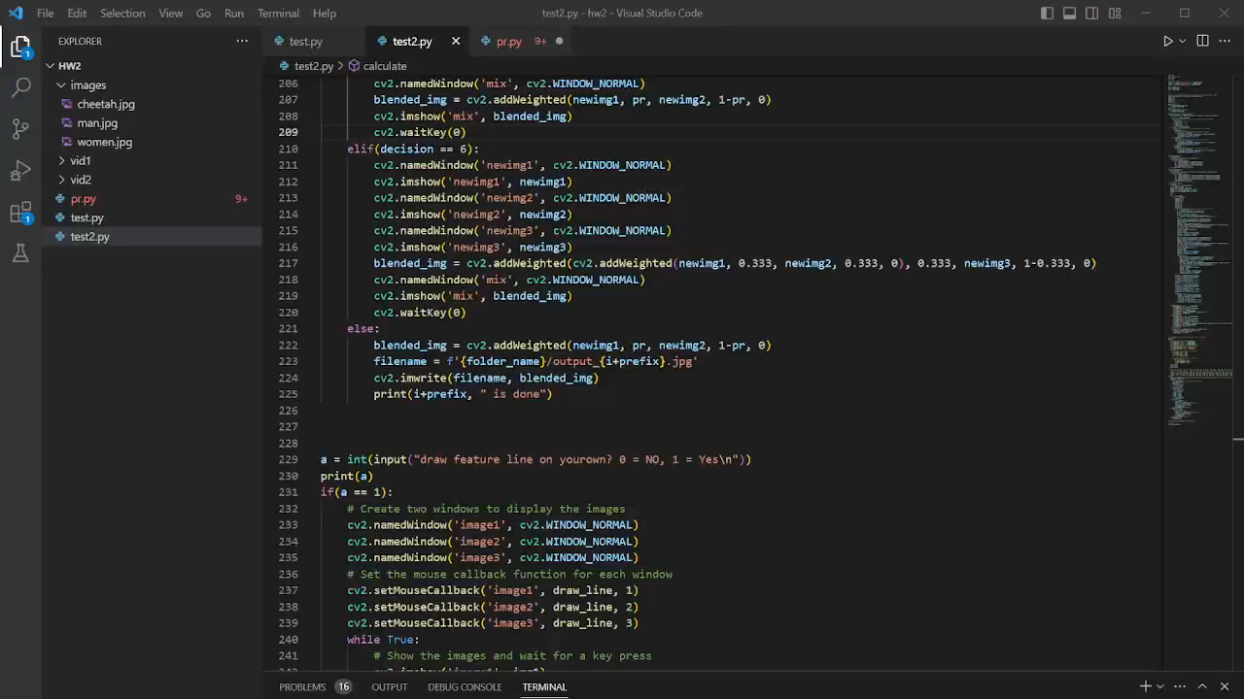

Slide 6
Submission
Compress your file into <student ID>_hw2.zip
E.g., p76123031_王語麟.zip
Your .zip file should include:
Source Code
Report (.pdf), including (1) Environment, (2) Method description and (3) How to run the program?
Demo video
Upload to Moodle.
Deadline: 2024/10/28(Mon.) 23:55

